Slide 1
ECE 322L Electronics 2
04/21/20 - Lecture 23
Class AB amplifiers

Slide 2
Overview
Class AB amplifiers
Definition and general architecture
Voltage-transfer characteristic (VTC)
Output resistance
Biasing configurations
(Neamen 8.3.3 and from 8.5.1 to 8.5.4-S&S, 6th edition, 11.5)

Slide 3
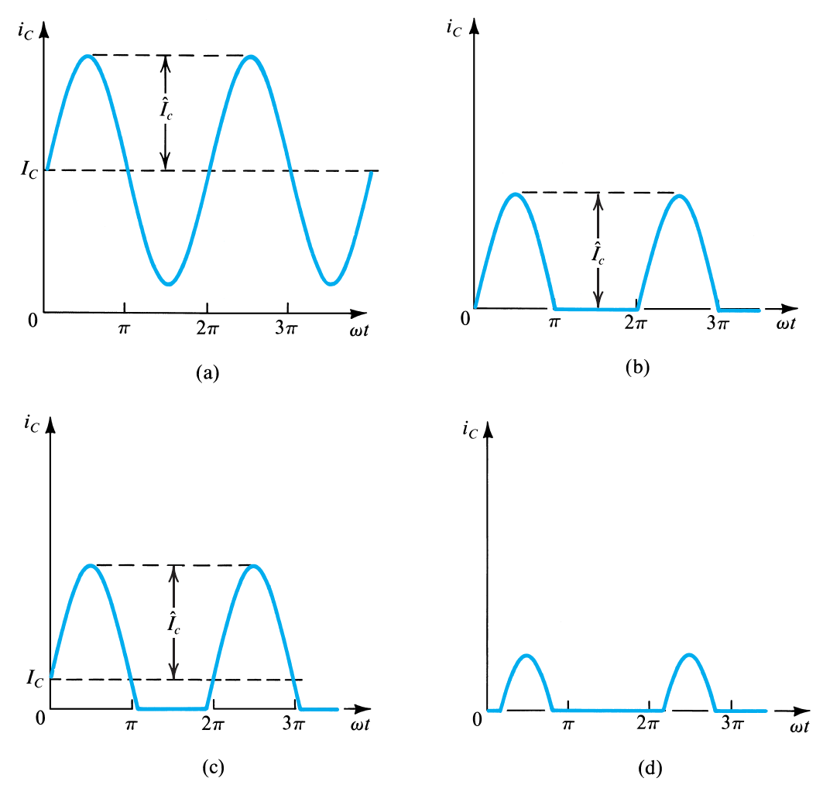
Classes of amplifiers
class A
class B
class AB
class C
Class-A: Output device(s) conduct through 360 degrees of input cycle (never switch off).
Class-B: Output devices conduct for 180 degrees (1/2 of input cycle).
Class-AB: Halfway (or partway) between the above two examples (181 to 200 degrees typical).
Class-C: Output device(s) conduct for less than 180 degrees (100 to 150 degrees typical)

Slide 4
Class A and class B amplifiers
Class A output stage is a simple linear amplifier.
It is also very inefficient, typical maximum efficiency is between 10 and 20 %.
Only suitable for low power applications.
A class B output stage can be far more efficient than a class A stage (78.5 % maximum efficiency compared with 25 %).
It also requires twice as many output transistors…
…and it isn’t very linear; cross-over distortion can be significant.

Slide 5
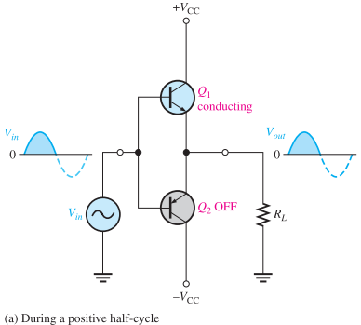
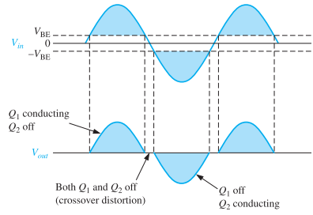
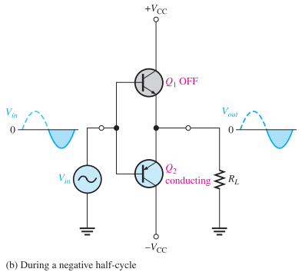
Class B amplifiers
When the dc base voltage is zero, both transistors are off and the input signal voltage must exceed VBE before a transistor conducts.
Because of this, there is a time interval between the positive and negative alternations of the input when neither transistor is conducting.
The resulting distortion in the output waveform is called crossover distortion.

Slide 6
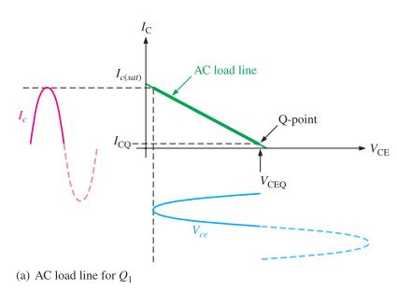
Class AB amplifiers
The DC collector current is NOT zero!
The DC collector current is lower than the peak amplitude of the ac collector current.
The DC collector current is very small, i.e., the Q point is close to the cut-off region.
Devices at the output stage conduct for more than 180 degrees (181 to 200 degrees typical).

Slide 7
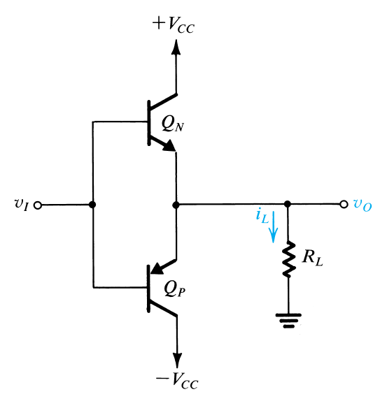
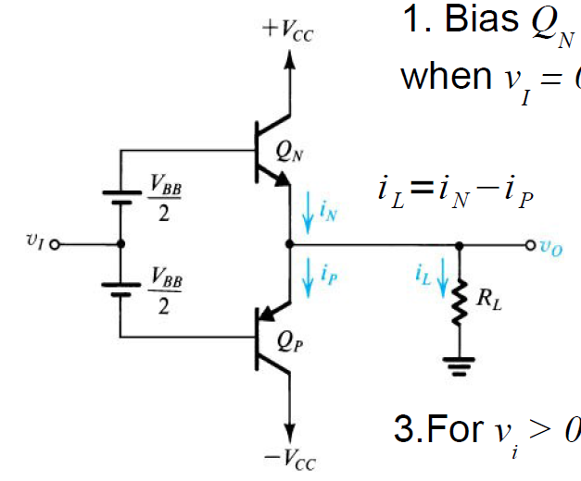
Push-pull: Class B vs Class AB
V_{BB}≥1.4
Source
Sink
i_{L}=i_{N} (v_{i}>0)
i_{L}=i_{P} (v_{i}<0)
Class B
Class AB

Slide 8
Class AB amplifier

Slide 9
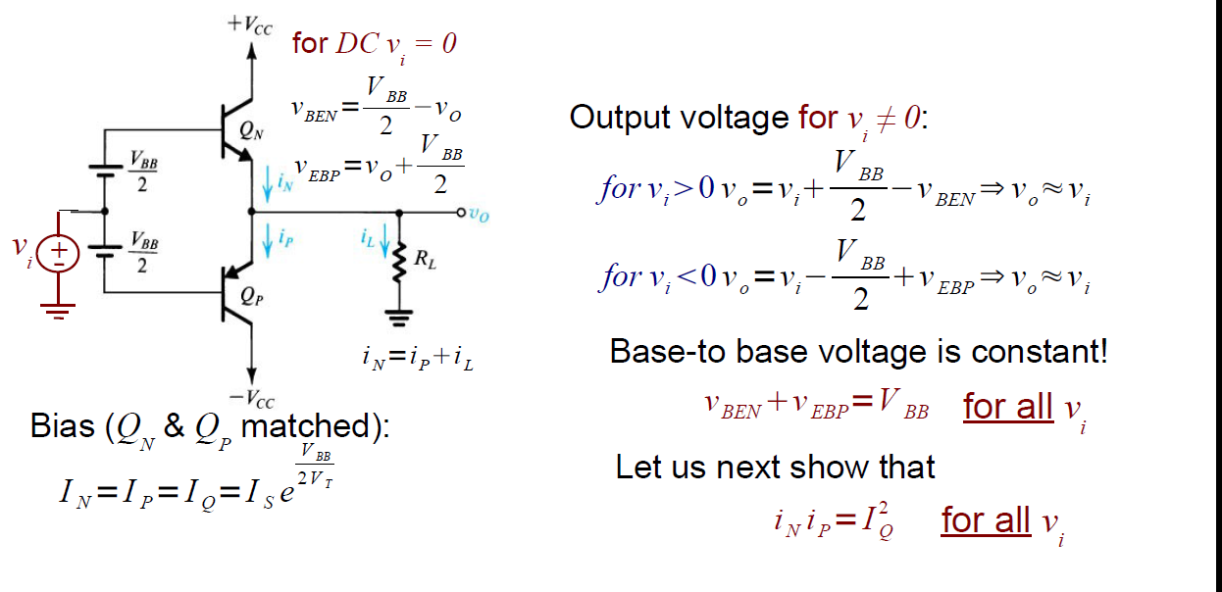
Circuit analysis & VTC
DC analysis
Devices are biased at a non-zero collector current!

Slide 10
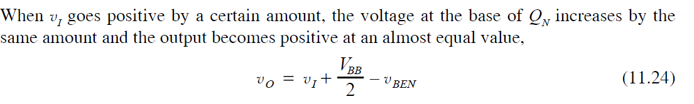
Circuit analysis & VTC
AC analysis

Slide 11
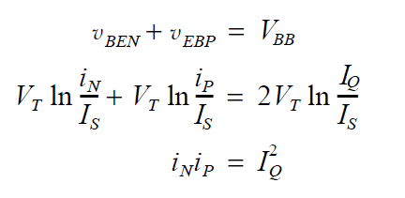
Circuit analysis & VTC
AC analysis
KVL at loop L
L
Constant
base voltage
condition

Slide 12
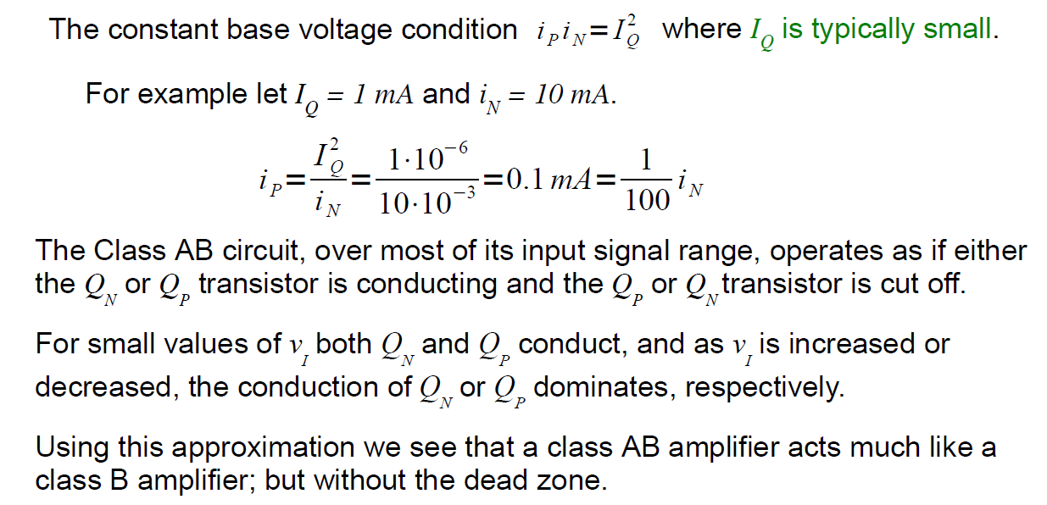
Circuit analysis & VTC

Slide 13
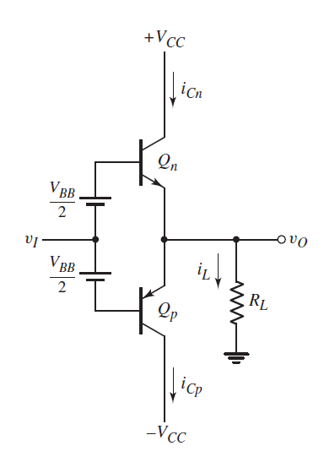
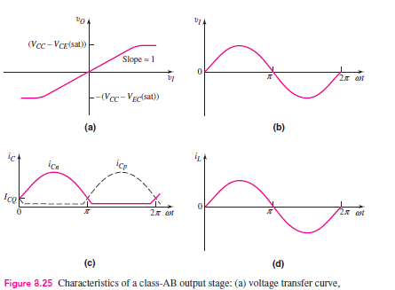
Signal voltages and currents

Slide 14
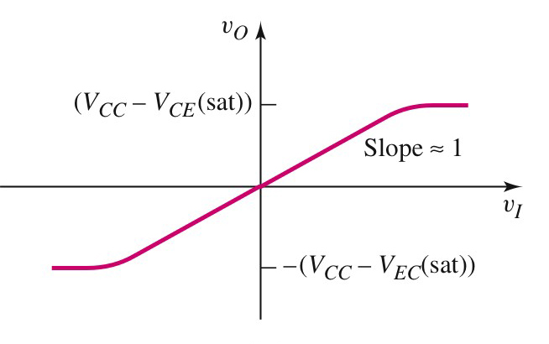
Voltage-transfer characteristic

Slide 15
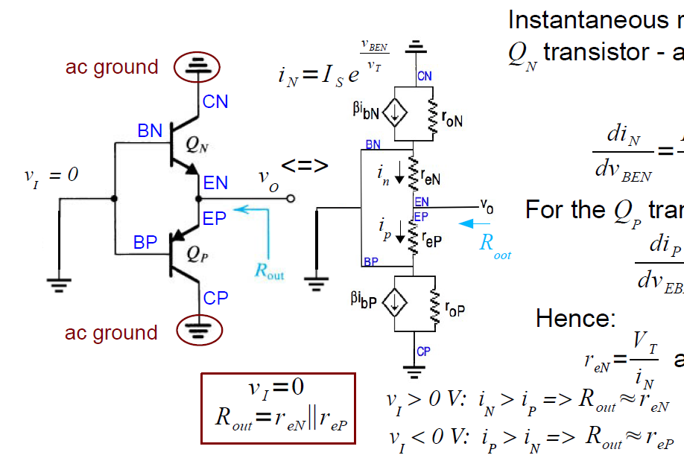
Output resistance
The output resistance is low. Great!

Slide 16
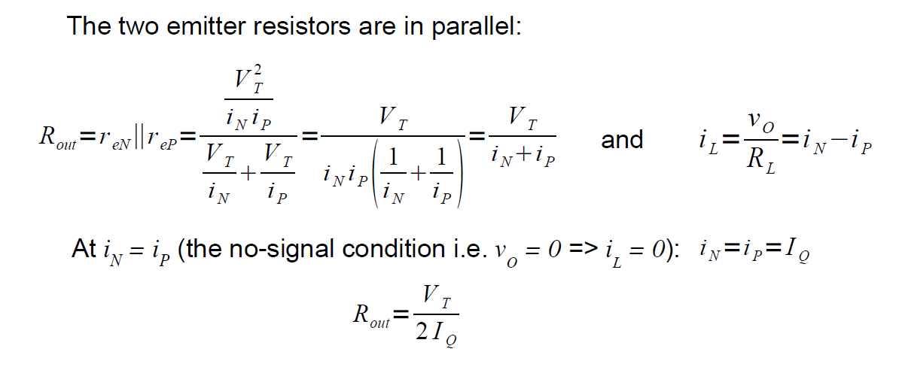
Output resistance

Slide 17

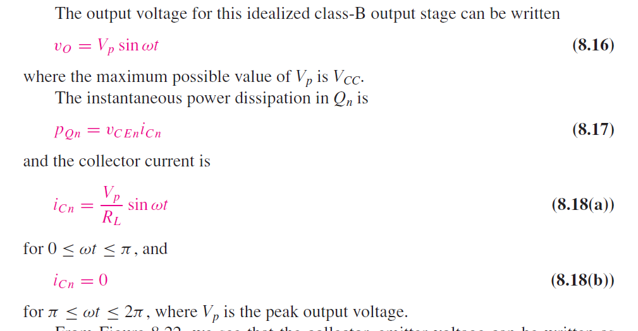
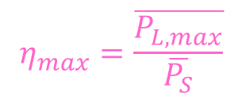

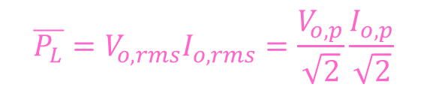
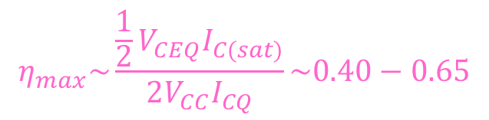
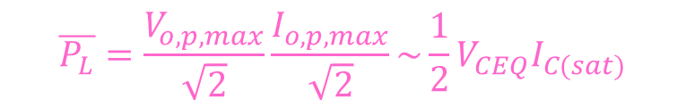
Efficiency
$$η_{max}=\frac{\overline{P_{L,max}}}{\overline{P_{S}}}$$
$$\overline{P_{L}}=V_{o,rms}I_{o,rms}=\frac{V_{o,p}}{\sqrt{2}}\frac{I_{o,p}}{\sqrt{2}}$$
$$\overline{P_{L}}=\frac{V_{o,p,max}}{\sqrt{2}}\frac{I_{o,p,max}}{\sqrt{2}}\sim \frac{1}{2}V_{CEQ}I_{C(sat)}$$
$$\overline{P_{S}}={2V}_{CC}I_{CQ}$$
$$η_{max}\sim \frac{\frac{1}{2}V_{CEQ}I_{C(sat)}}{2V_{CC}I_{CQ}}\sim 0.40−0.65$$

Slide 18
Class AB amplifiers
A class B output stage can be far more efficient than a class A stage (~40-65% maximum efficiency compared with 25 %) but less efficient than a class B stage (~40-65 % maximum efficiency compared with 78.5 %).
No cross-over distortion
Suitable for large signals
Intermediate characteristics between class A and B.

Slide 19
Class AB amplifier
How can one practically realize the DC voltage V_{BB}?

Slide 20
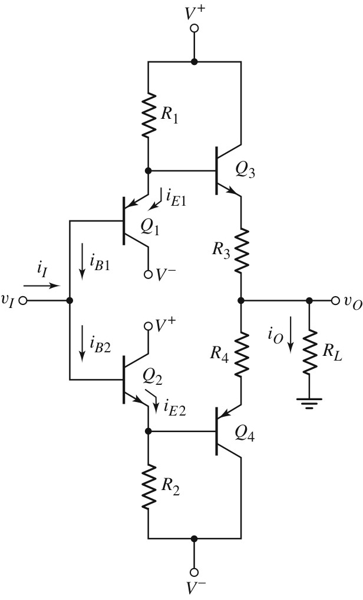
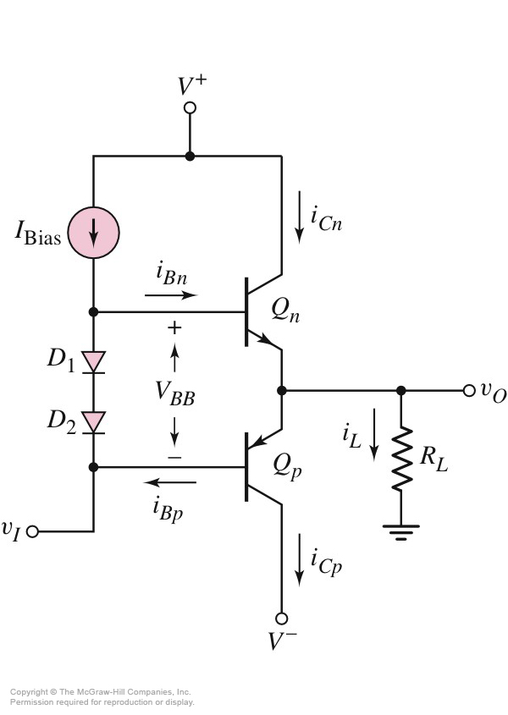
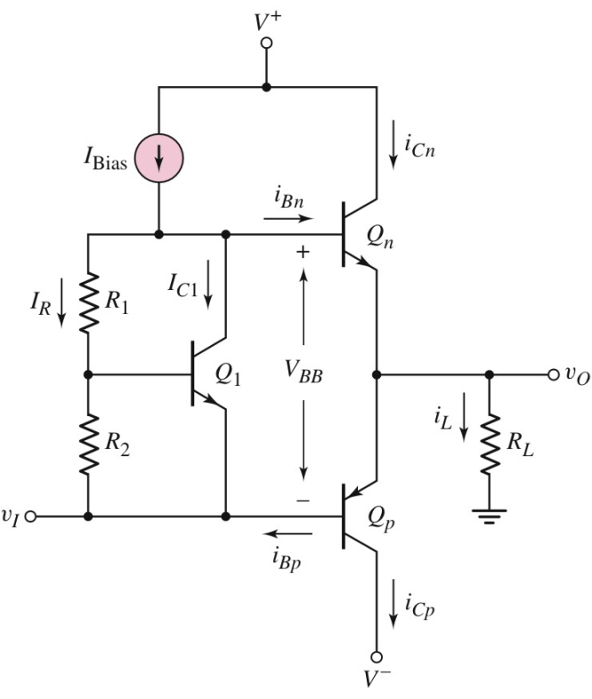
Biasing of class AB amplifiers (push-pull AB)
Diode biasing
Biasing with V_{BE} multiplier
Biasing with input buffer transistor

Slide 21
Diode biasing
The biasing circuit comprising D₁, D₂, I_{Bias}, and V⁺ provides the biasing voltage V_{BB}.
Current mirror
Diode connected transistors

Slide 22
Diode biasing
Disadvantage:
V_{BB} is not stable against variations of the output voltage.
As the input voltage increases, the output voltage increases, causing an increase in i_{Cn}. This in turn produces an increase in the base current i_{Bn}. Since the increase in base current is supplied by I_{Bias}, the current through D₁ and D₂, and hence the voltage V_{BB}, decreases slightly.

Slide 23
Diode biasing
Benefit: prevents thermal runaway in the output devices if D₁ and D₂ are in thermal contact with them.
As the the temperature of the B-E junctions of the output devices increases, the biasing diodes that are in thermal contact with the emitter junctions will see an increase in temperature. As result the diode currents are going to increase and the base currents of the transistors are going to decrease, which leads to a decrease of the V_{BEn} (V_{EBp}) and of the i_{Cn} (i_{Cp}).

Slide 24

Biasing using a V_{BE} multiplier
The biasing circuit comprising Q₁, R₁, R₂ and I_{Bias}, provides the biasing voltage V_{BB}.
Neglecting the base current of Q₁;
Design parameters
Thus, V_{BB} can be set by selecting suitable values for R₁ and R₂.

Slide 25
Biasing using a V_{BE} multiplier
As v_{I} increases, i_{Cn} increases followed by an increase of i_{Bn}. i_{C1} decreases but v_{BE1} is almost constant.
Bias is relatively stable against large variations of the output current.
It prevents thermal runaway in the output devices if Q₁ is in thermal contact with them. (Why? Test your understanding trying to answer)

Slide 26
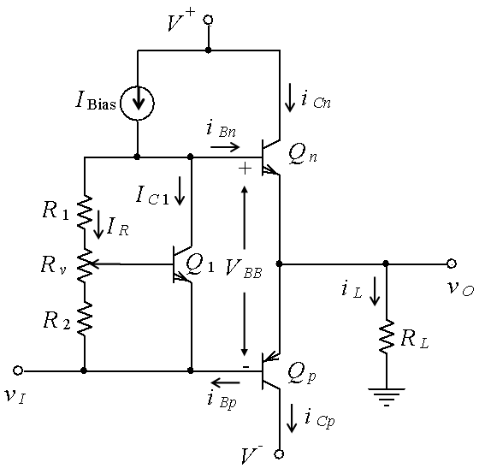
Biasing using a V_{BE} multiplier
To facilitate adjustment of the ratio R₁/R₂ and hence, the value of V_{BB}, a third resistor R_{v} is typically included in the circuit.

Slide 27
Biasing using buffer transistors
R₁, R₂ and the emitter-followers Q₁ and Q₂ establish the required quiescent bias.
The outputs of Q₁ and Q₂ follow the input signal and drive Q₃ and Q₄.
Benefits: stability and high current gain.

Slide 28
Stability
When the input voltage v_{I} increases, the base voltage of Q₃ increases and the output voltage v_{O} increases. The emitter current of Q₃ increases to supply the load current i_{O}.
The base current and the base voltage of of Q₃ both increase. The increase in base voltage of Q₃ reduces the voltage across, and the current through R₁. This means that i_{B1} and i_{E1} also decrease and the v_{BE1} stays more or less constant.

Slide 29
Current gain
Neglecting and
we have;
and;

Slide 30
Current gain
If;
and;
then;

Slide 31
Biasing using buffer transistors
Since the voltage gain is approximately unity, the output current is;
The current gain is;
which is quite substantial. A large current gain is desirable since the output stage must typically deliver large currents to a load

Slide 32
In-class problem 1
A diode biasing class AB power amplifier is to meet the following specifications:
R_{L} = 8 Ω;
Average output power delivered to the load P_{L} = 5 W;
peak output voltage to be not more than 80% of V_{CC};
minimum value of I_{D} to be no less than 5 mA

Slide 33
In-class problem 1
For both Q_{n} and Q_{p};
For D₁ and D₂
Determine;
a) I_{Bias} and V_{CC};
b) The quiescent collector current
c) i_{Cn} and i_{Cp} and V_{BB} when the output voltage is at its peak positive value

Slide 34
In-class problem 1, solution
a)
Select V_{CC} = 12 V

Slide 35
In-class problem 1, solution
At the positive peak of the output voltage;

Slide 36
In-class problem 1, solution
To maintain a minimum of 5 mA through the diodes;
Select I_{Bias} = 20 mA

Slide 37
In-class problem 1, solution
b)
Under quiescent condition (v_{I} = 0), I_{D} = 20 mA (neglecting i_{Bn});

Slide 38
In-class problem 1, solution
Assuming Q_{n} and Q_{p} are matched transistors;
Hence;

Slide 39
In-class problem 1, solution
c)
At the peak positive value of output voltage;

Slide 40
In-class problem 1, solution

Slide 41
In-class problem 1, solution

Slide 42
In-class problem 1, solution
Hence, when the output voltage is at its peak positive value;
and;

Slide 43
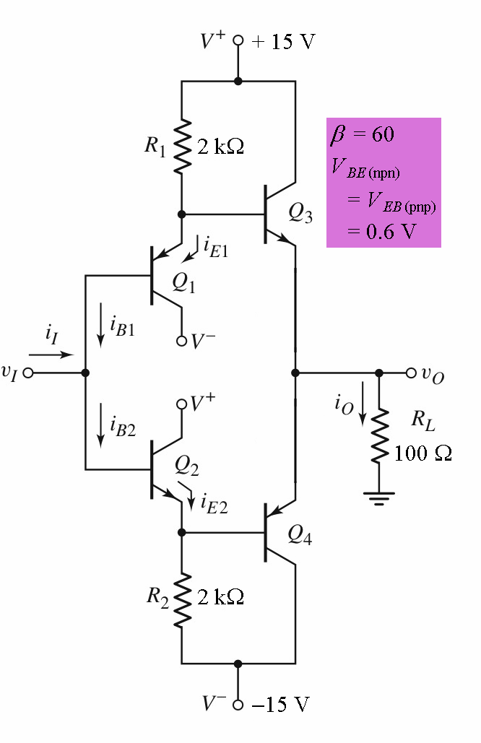
Take-home problem 1
Determine the quiescent bias currents in all transistors;
Calculate all the currents labeled in the figure and the current gain when v_{I} = 10 V.

Slide 44
Take-home problem 1, solution
(a) For v_{I} = 0 (quiescent currents);
Assuming all transistors are matched, the bias currents in Q₃ and Q₄ are also approximately 7.2 mA since the base-emitter voltages of Q₁ and Q₃ are equal and those of Q₂ and Q₄ are equal.

Slide 45
Take-home problem 1, solution
(b) For v_{I} = 10;
Because the voltage gain is approx. unity;

Slide 46
Take-home problem 1, solution

Slide 47
Take-home problem 1, solution
Since Q₄ tends to turn off when v_{I} increases, i_{B4} is negligible. Therefore;
47

Slide 48
Take-home problem 1, solution
The input current;
The current gain;

Slide 49
Take-home problem 1, solution
If the previous expression i.e.
is used,
we have;
The higher gain is due the fact that the base currents of Q₃ and Q₄ are neglected in deriving the expression.

